Slide 1


Spark data analysis
ISM 6362 – Big Data and Cloud-Based tools
Nicholas Catani

Slide 2


AGENDA
INTRODUCTION
Data loading
Data preprocessing task 1: aggregation task 2: window function task 3: pivot table task 4: multi-level aggregation
Challenges and solutions
Strengths and limitations of spark

Slide 3

Introduction
This assignment aims to gain hands-on experience with Apache Spark and its data analysis capabilities. Using the “GlobalLandTemperature” dataset, various aggregation techniques were applied to analyze temperature data. The tasks included aggregation by key, window functions, pivot tables, and multi-level aggregation. This report summarizes the findings, discusses the challenges encountered, and reflects on the strengths and limitations of using Apache Spark for data analysis.

Slide 4
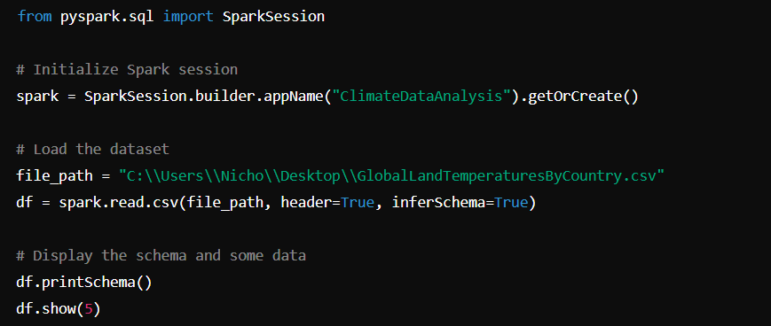
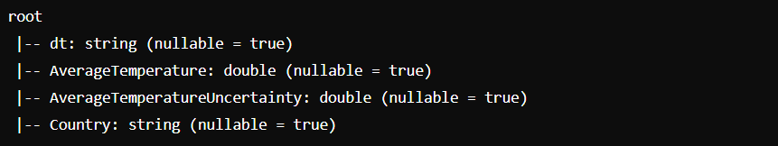
Data loading

Slide 5
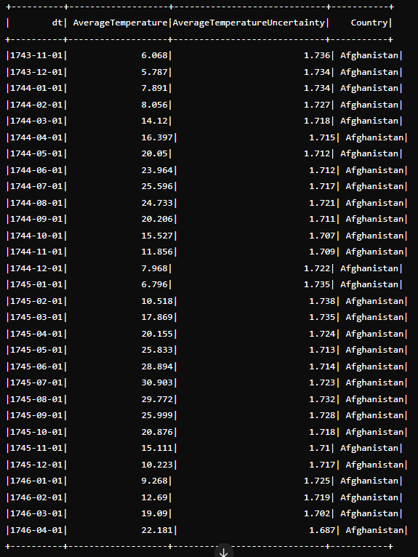

Slide 6

Data preprocessing
The code involved cleaning the dataset by removing rows with null values and filtering the data to include only records after the year 1900.

Slide 7
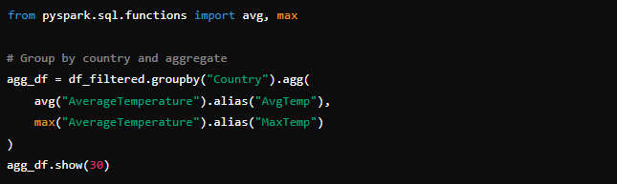
Task 1: aggregate by key
The aggregation by country revealed significant variations in average and maximum temperatures across different countries. For instance, tropical countries like Djibouti and Dominica exhibited high average temperatures, while countries with varied climates like Russia and Armenia showed much lower average temperatures.
This analysis underscores the diversity in climatic conditions globally. The highest maximum is in countries like Kuwait (39.36°C) highlighting extreme heat conditions, while the moderate temperatures in countries like Germany and Luxembourg indicate mild climates.

Slide 8
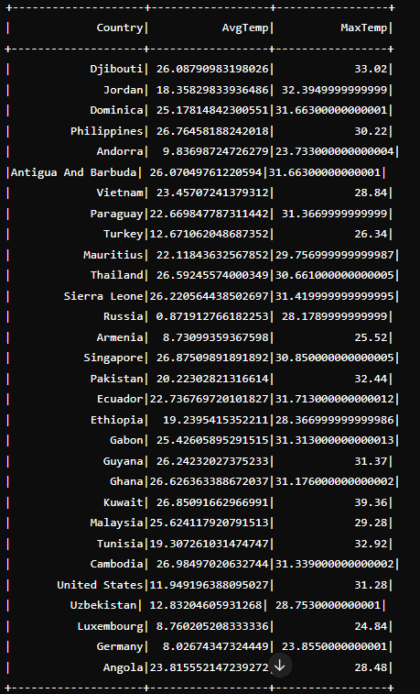

Slide 9
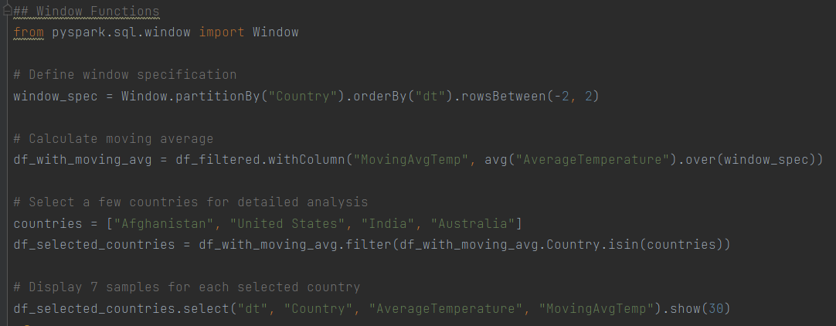
Task 2: window function
The moving average calculation provides a smoother trend of temperature changes over time, reducing the impact of short-term fluctuations, This is particularly useful in climate studies where long-term trends are more meaningful than short-term variations.
For instance, the moving average of Afghanistan reveals a gradual increase in temperature over the months, which might be indicative of seasonal patterns. Similar trends can be observed in the United States, India, and Australia, highlighting both seasonal and long-term temperature variations.

Slide 10
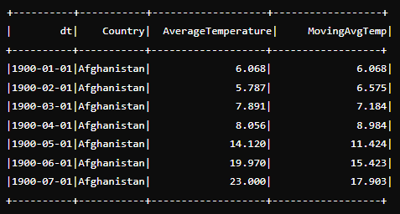
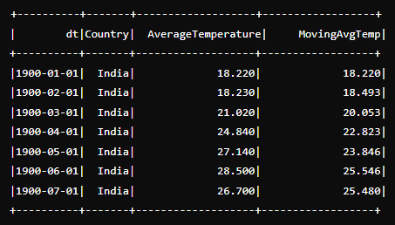
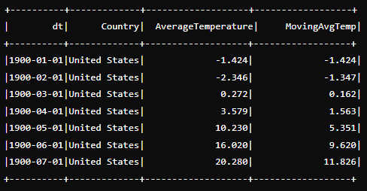
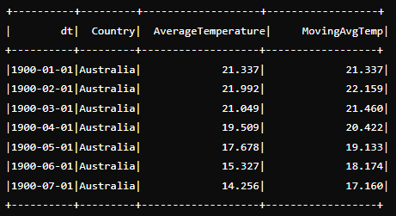

Slide 11
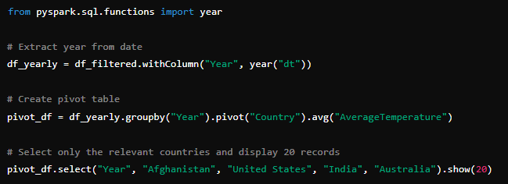
Task 3: pivot table
The pivot table highlights yearly temperature variations across different countries, facilitating comparative analysis.
In 1900, the average temperature in Afghanistan was 11.89°C, while in Australia it was 19.72°C, in India it was 23.79°C, and in the United States it was 7.35°C. This comparison reveals significant differences in climate among these countries.

Slide 12
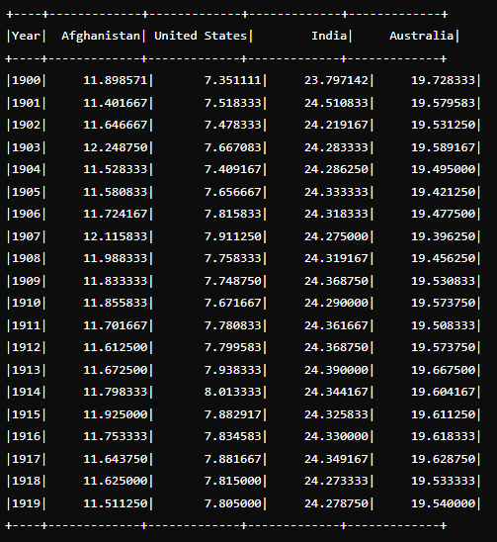

Slide 13
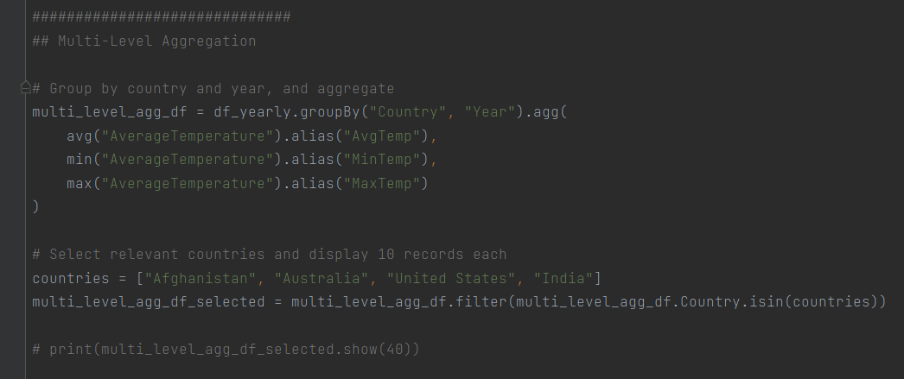
Task 4: Multi-level aggregation

Slide 14
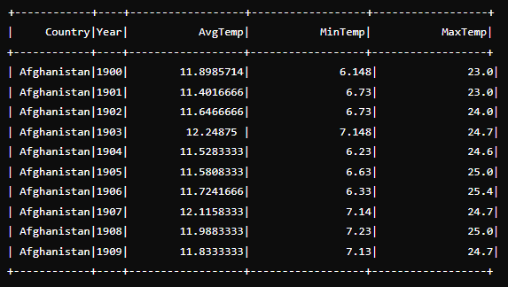
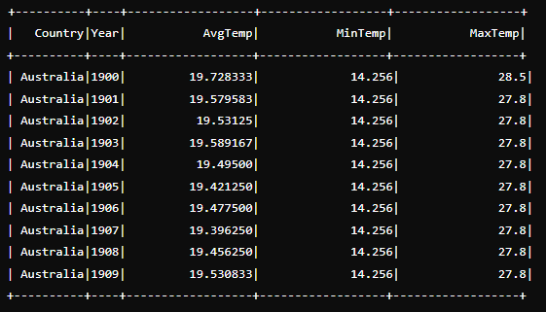
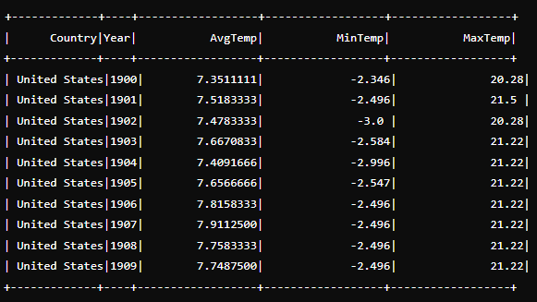
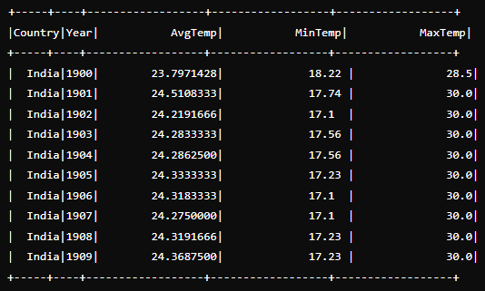

Slide 15
Task 4: Multi-level aggregation

Slide 16

Challenges and solutions
Challenge: The dataset was extensive, which made processing time-consuming and computationally extensive.
Solution: Filtering the dataset to include records only after the year 1900 helped manage the size and complexity, making the analysis more efficient.
Future approach: Instead of filtering the dataset from 1900, I would consider focusing on more recent data, such as records from 2015.
Challenge: Performing multi-level aggregation required careful handling to ensure accuracy and meaningful results.
Solution: Grouping data by country and year, and then calculating average, minimum, and maximum temperatures provided comprehensive insights.
Future approach: I would explore more advanced aggregation techniques and consider additional dimensions for multi-level analysis.
Challenge: The dataset contained numerous null values, which could skew the results if not handled properly.
Solution: The null values were removed using the “dropna()” method to ensure that the dataset was clean and reliable for analysis.
Future approach: I would consider imputation strategies for handling null values instead of simply dropping them, to retain as much data as possible.
Challenge: I encountered warnings related to Hadoop’s native library during Spark setup.
Solution: I configured the log4j properties to suppress specific warnings and focused on ensuring core functionalities were unaffected.
Future approach: I would spend more time configuring the environment correctly and exploring different configurations to avoid such issues.

Slide 17
Strengths and limitations of spark
SCALABILITY:
Apache Spark is designed to scale up from a single server to thousands of machines, each offering local computation and storage. This scalability makes it suitable for handling large datasets efficiently. In the context of data analysis, Spark’s ability to process extensive historical temperature records from multiple countries quickly and effectively demonstrates its scalability.
COMPLEXITY IN CONFIGURATION AND MANAGEMENT:
Setting up and configuring Spark can be complex, particularly for beginners. Proper tuning of parameters, management of cluster resources, and dealing with various configurations can be challenging. During the Spark setup for this assignment, encountering warnings related to Hadoop’s native library required specific configurations in the “log4j.properties” file to suppress these warnings. Ensuring the Spark environment was correctly configured to avoid performance issues and errors highlighted the complexity of managing a Spark cluster.
2. RESOURCE INTENSIVE:
While Spark is highly efficient, it can be resource-intensive, requiring significant memory and CPU resources, especially when dealing with very large datasets. This can lead to high operational costs and the need for robust infrastructure. In this assignment, handling the large climate dataset required careful management of system resources. Filtering the data to include only records from 1900 onwards was necessary to make the processing more manageable and to avoid running into resource constraints.
2. VERSATILITY:
Spark supports a wide range of data processing tasks beyond simple aggregations, including machine learning, stream processing, and graph processing. Its versatile API provides rich functionality for complex data transformations and analyses. During the multi-level aggregation task, Spark’s versatile functions enabled a comprehensive analysis of temperature trends across different dimensions. This versatility allows for more detailed and varied analyses compared to traditional data processing tools.

